Slide 1
Patent for Container Holding a Flexible Coffee Bag
US D593,796 S
Canadian patent No. 129204

Slide 2
Coffee bag Container
Background:
The Coffee bag container was designed for keeping coffee bags upright on the countertop or inside a cupboard
The containers are versatile in that you can use them for other things such as desk ornaments to hold pens, pencils; planters or vase for flowers;
Good for promotion of products: fundraising; Christmas gifts, etc.

Slide 3
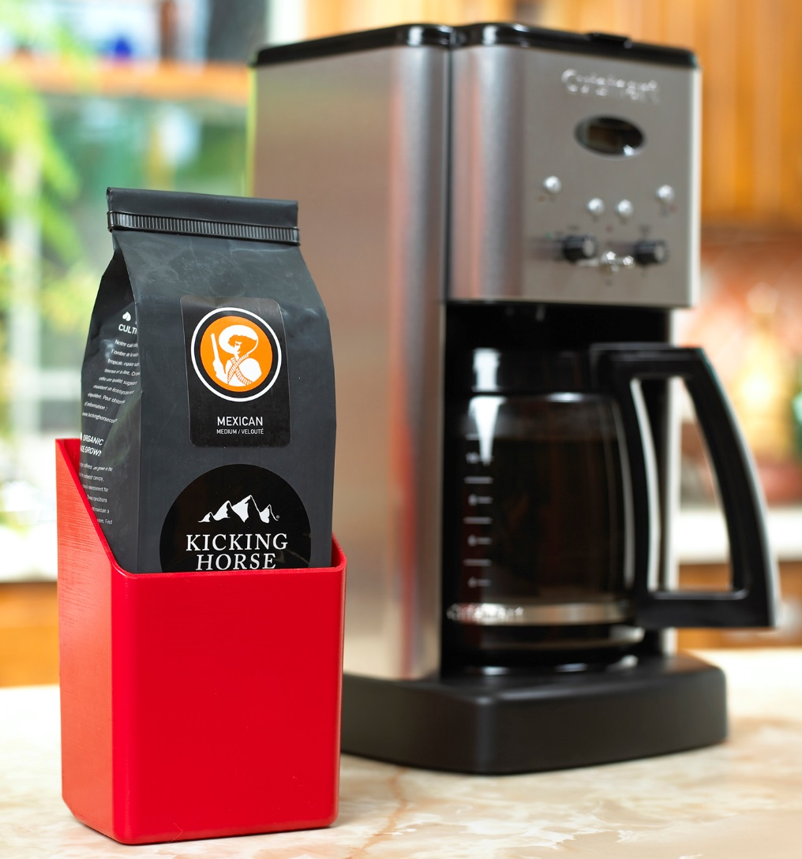
Prototype of Container

Slide 4
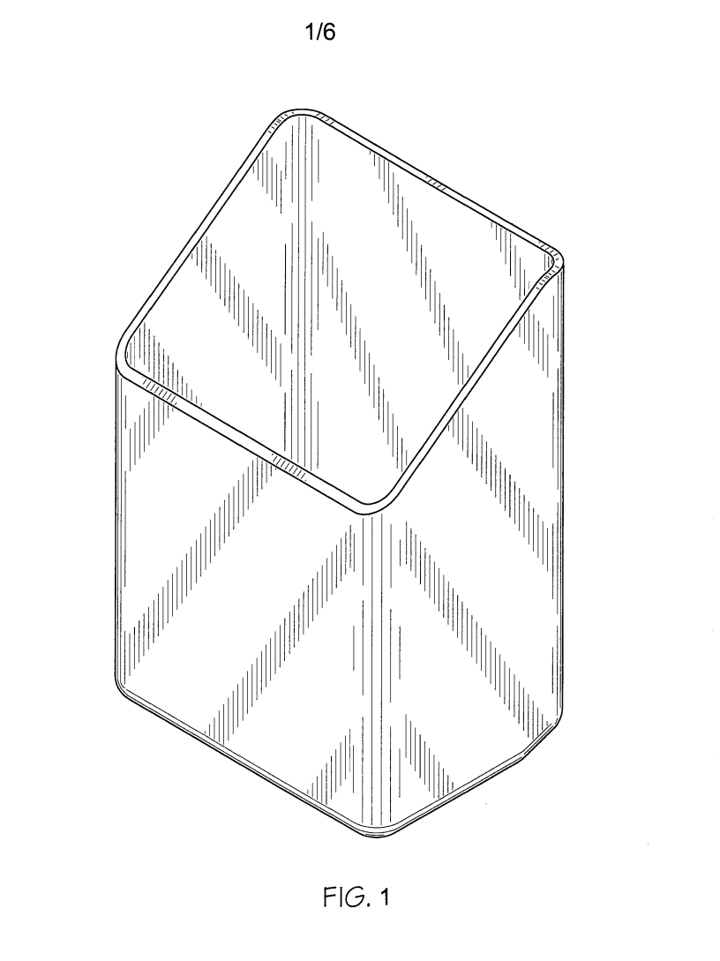
Coffee bag Container

Slide 5
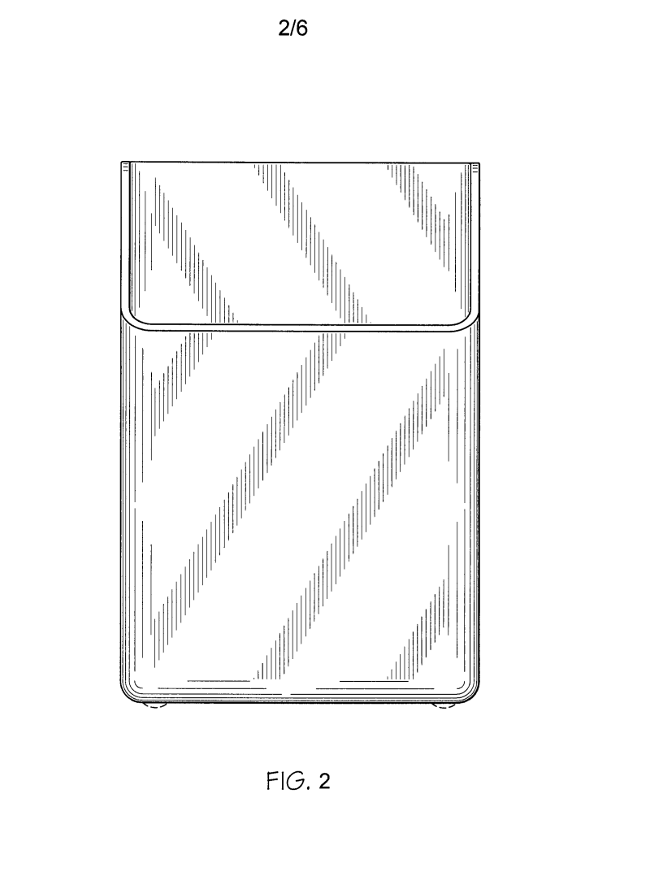
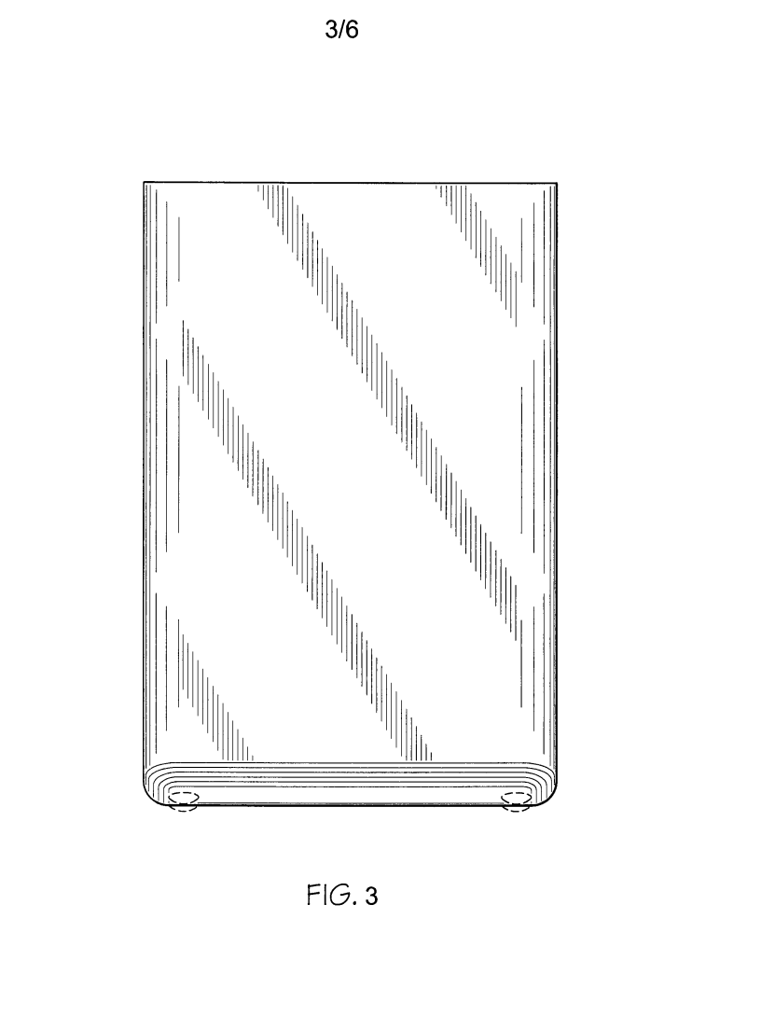
Coffee bag Container

Slide 6
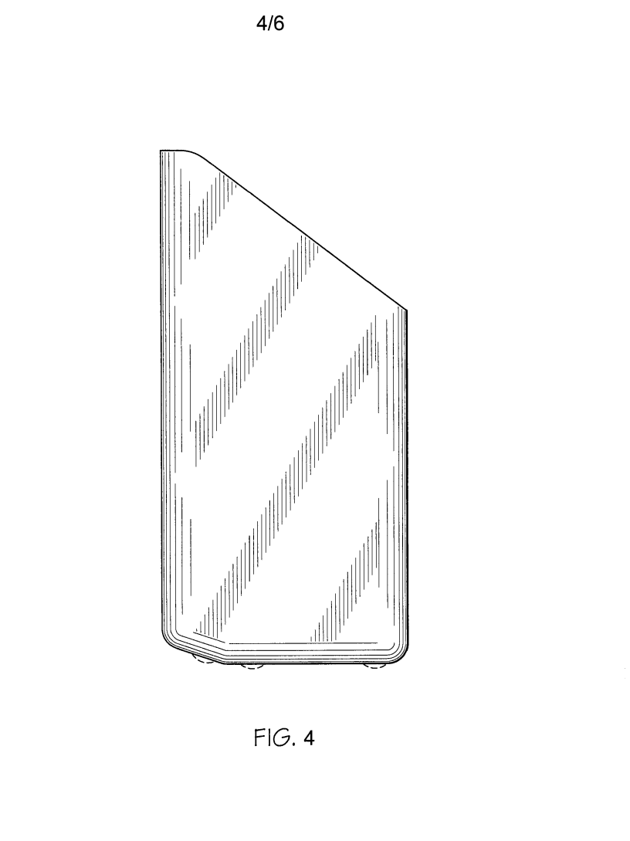
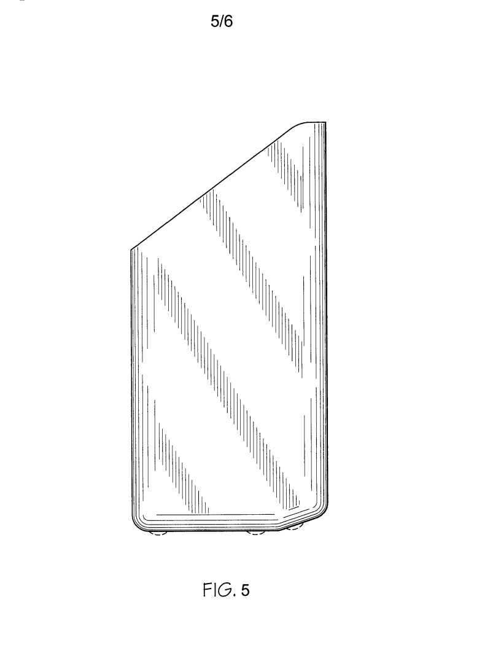
Coffee bag Container

Slide 7
Licensing or Selling of Patents
Enviroquest Ltd. is holder of both patents.
We are looking for a company to license or buy our patents to produce the flexible bag container.
Please contact Sherrene Kevan, President
At 519-658-0573 or by cell at 519-222-4163

Slide 8
Our Canadian Patent Lawyers
Agent:
GOWLING LAFLEUR HENDERSON LLP
160 ELGIN STREET, SUITE 2600
OTTAWA, K1P 1C3
ONTARIO, CANADA

